Slide 1

Software Production Engineering
SDLC, Jenkins and CI/CD Pipeline

Slide 2
Agenda
Understanding the working of traditional SDLC approach
Introduction to Jenkins as a CI tool
Creating Jobs in Jenkins and execute internally as well as remotely
Sending email notifications to update status
Parameterised jobs and their need
User Management - Configuring role-based strategy plugin
Integrating Jenkins with Git via Poll SCM and web hooks
CI/CD pipeline creation using Jenkins file
Setting up master slave architecture in Jenkins

Slide 3
Introduction to CI/CD

Slide 4
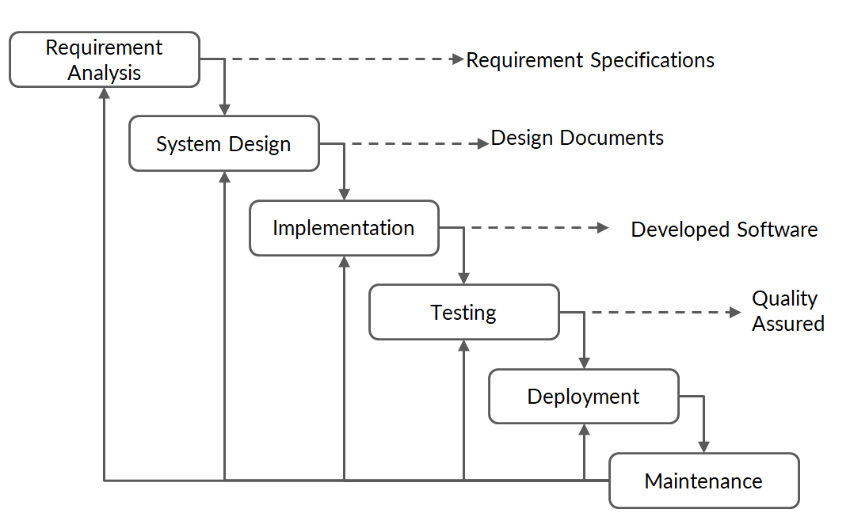
Software Development Life Cycle
Notes:
Software Development Life Cycle (SDLC) is a process used by the software industry to design, develop and test high quality software’s.
The life cycle defines a methodology for improving the quality of software and the overall development process. Requirement analysis is performed by the senior members of the team with inputs from the customer, the sales department, market surveys and domain experts in the industry.
At the end they have come out with SRS (Software Requirement Specification) document which consists of all the product requirements to be designed and developed during the project life cycle.
SRS is the reference for product architects to come out with the best architecture for the product to be developed. The internal design of all the modules of the proposed architecture should be clearly defined in Design Document Specification (DDS).
In this stage of SDLC the actual development starts and the product is built. The programming code is generated as per DDS during this stage.
Testing stage of the product - where product defects are reported, tracked, fixed and retested, until the product reaches the quality standards defined in the SRS.
Once the product is tested and ready to be deployed it is released formally.

Slide 5
Introduction to CI/CD
In software engineering, continuous integration (CI) is defined as a process of integrating all developers' code to a shared repository in a version-control system frequently.
The term CI was first proposed by Grady Booch in 1991.
CI is supposed to be used in conjunction with automated build, test, and QA.
A build server compiles the code and reports the results to the developers on a regular basis, or even after each commit.
Test: Unit test in the developer's local environment before committing to the mainline helps avoid one developer's work-in-progress while breaking another developer's copy.

Slide 6
Introduction to CI/CD
Along with running the unit and integration checks, you can check the quality of your code and profile performance and format the documentation from the source code, thereby facilitating QA processes.
This quality check application mainly aims to enhance software quality and reduce delivery time continuously.
CI is connected closely with continuous delivery or continuous deployment, which is also called the CI/CD pipeline.
‘Continuous delivery’ ensures that the incremental feature of a software product checked in on the mainline is ready to deliver to the end user.
‘Continuous deployment’ makes the deployment process fully automated.

Slide 7
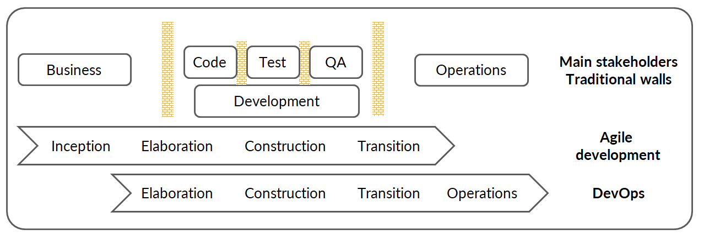
Drawbacks of Traditional SDLC
Agile breaks the wall between Business and Development teams.
DevOps breaks the wall between Development and Operations teams.
DevOps centres on the concept of sharing (ideas, issues, processes, tools and goals).
Notes:
Inception: The vision of the software product is developed, a project scope is defined, and the business case is justified.
Elaboration: Requirements are gathered and defined, risk factors are identified, and a system architecture is initialized.
Construction: The software is developed and ready to be delivered to the user.
Transition phase is from development to operations.
Operations: The software is available to the user and is maintained by the operations team.

Slide 8
Continuous Integration
CI, in its simplest form, involves a tool that continuously monitors version-control systems for any new changes.
Whenever any new changes are pushed, this tool starts compiling and testing your application.
If a bug is found or the code fails, the developers are immediately notified to fix the issue.
If you integrate it with automated end-to-end acceptance checks, CI can serve as a feedback method, offering a straightforward image of the current state of development efforts.
It will allow you to deploy the latest version of your application either automatically or as a one-click process.

Slide 9
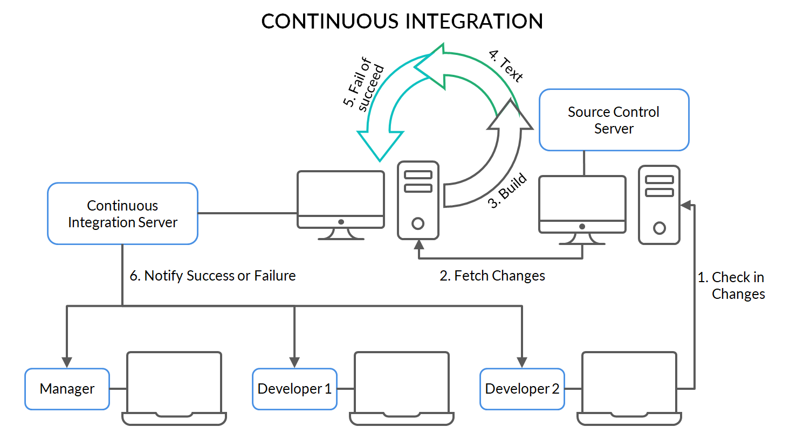
Continuous Integration
Test

Slide 10
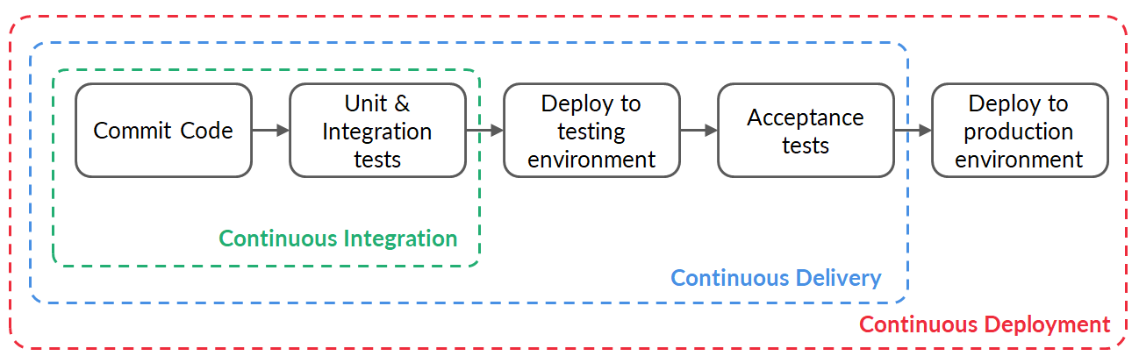
Continuous – Integration, Delivery and Deployment
Notes:
“A mistake in coding is called Error, error found by tester is called Defect, defect accepted by development team then it is called Bug, build does not meet the requirements then it is Failure.”
Verification is the process of determining: Whether output of one phase of development conforms to its previous phase.
Validation is the process of determining: Whether a fully developed system conforms to its SRS document.
Integration test: After different modules of a system have been coded and unit tested and then modules are integrated in steps according to an integration plan.
Acceptance Test: System testing performed by the customer himself: to determine whether the system should be accepted or rejected. Test software with the client’s environment and real data, performed by the SQA team in the presence of client representatives, or an independent SQA team hired by the client

Slide 11
Benefits of CI/CD
Automation – ensures build, test, QA, delivery and deployment
Improves consistencies and quality of code
Delivers new features quickly to the end user
Increases product visibility
Helps avoid manual errors
Helps fix any issues that may arise
Reduces costs and labour

Slide 12
Introduction to Jenkins

Slide 13
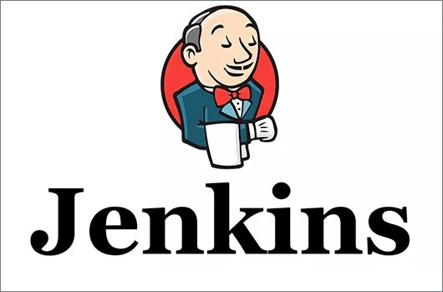
Jenkins – An Introduction
Jenkins is basically a free and open-source automation server.
Jenkins can be used to automate all types of software development tasks such as building, testing, and delivering or deploying software.
Jenkins can be installed via native system packages, Docker, or it can be run standalone on any computer.

Slide 14
How Jenkins Evolved
Jenkins is the outcome of an innovative developer, Kohsuke Kawaguchi, who began this project as a hobby under the name Hudson in late 2004 while working at Sun Microsystems.
In 2009, Sun Microsystems was acquired by Oracle. At the end of 2010, tensions arose between the Hudson developer community and Oracle. Initially, the problem was with the Java.net infrastructure, which later worsened due to issues related to Oracle's claim to the Hudson trademark.
In January 2011, the Hudson developer community decided to rename the project as Jenkins. Subsequently, they migrated the original Hudson code base to a new GitHub project and continued their work there.
After this, the majority of users joined the Jenkins developer community, migrating to Jenkins.

Slide 15
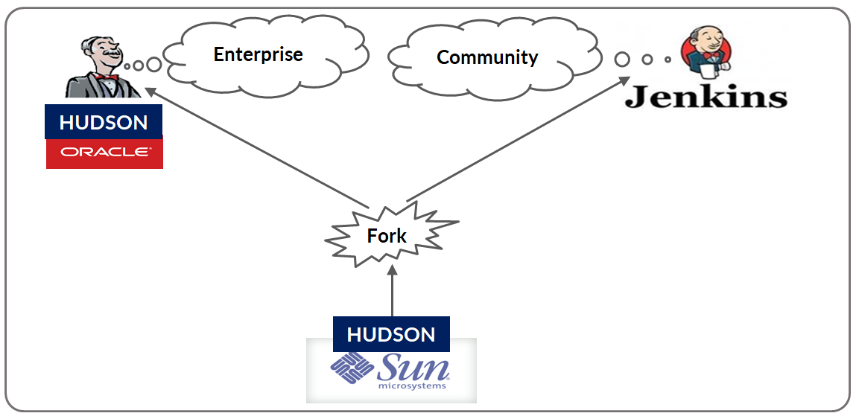
History of Jenkins

Slide 16
Features of Jenkins
Jenkins, originally called Hudson, is an open-source CI tool written in Java.
Jenkins is a very user-friendly tool, with a simple, intuitive and visually appealing user interface.
Jenkins has a very low learning curve.
Jenkins is an extremely flexible tool and hundreds of open-source plugins are available, with more coming up every week.

Slide 17
Features of Jenkins
These plugins cover everything from version-control systems, build tools, code quality metrics and build notifiers to integration with external systems, UI customisations, and much more.
The Jenkins community is a large, dynamic, reactive and welcoming bunch, with passionate champions, active mailing lists, IRC channels and a very vocal blog and Twitter account.
.
The pace of development is quite fast, with the latest new features, bug fixes, and plugin updates being released on a weekly basis.
Jenkins is a JAVA application, so it is platform independent.
Notes:
Internet Relay Chat (IRC) is an application layer protocol that facilitates communication in the form of text.

Slide 18
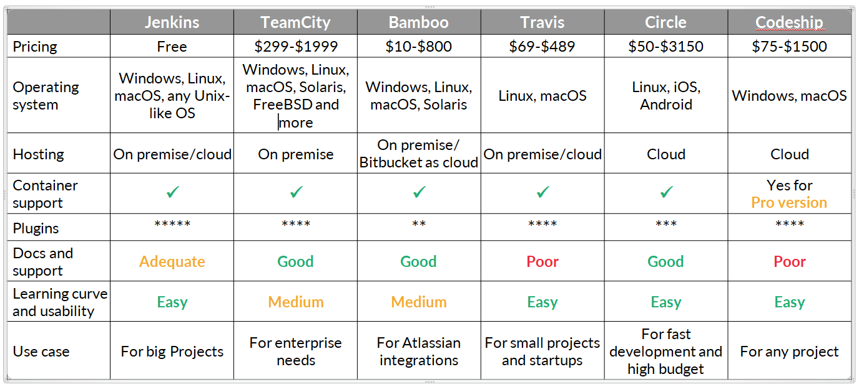
Comparison of CI Tools

Slide 19
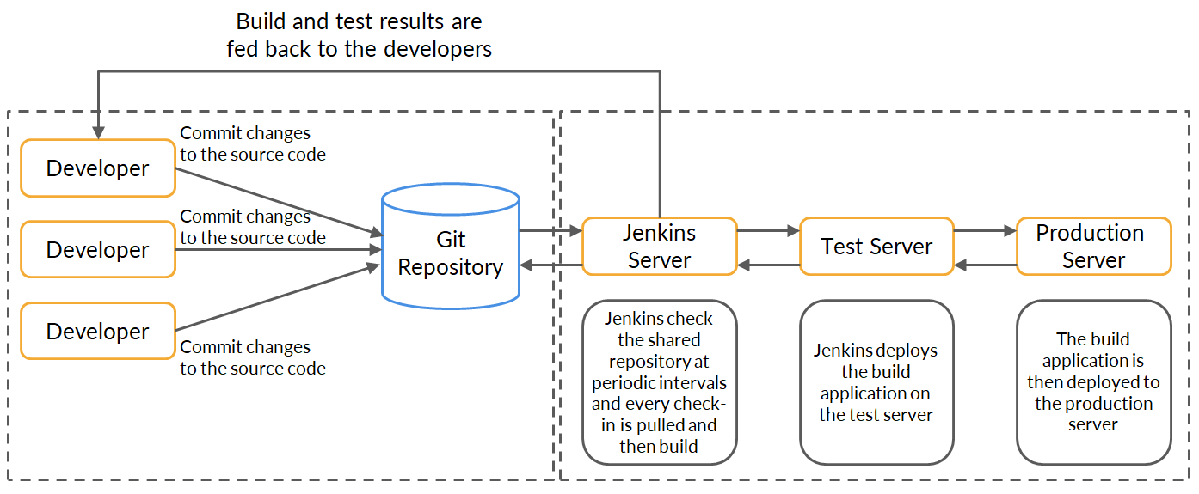
Jenkins Architecture

Slide 20
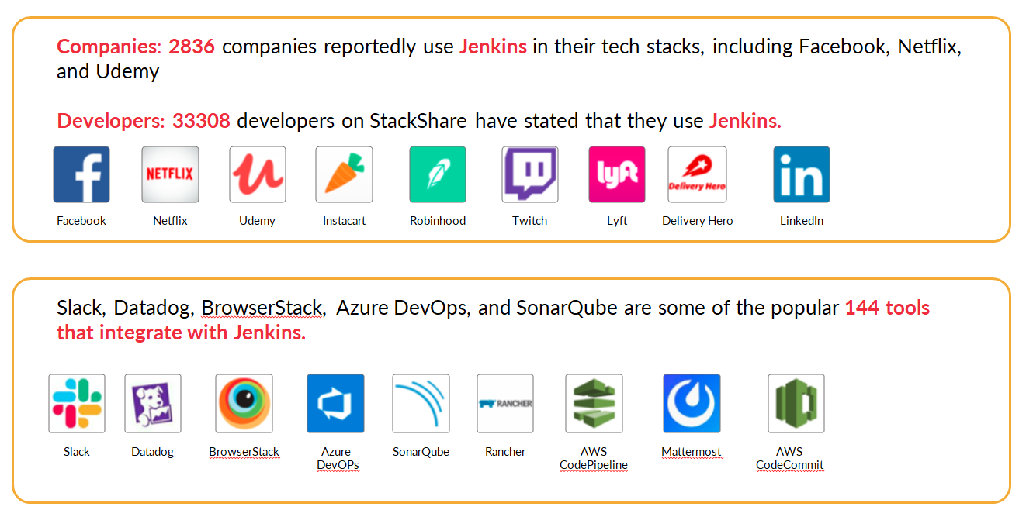
Companies That Use Jenkins

Slide 21
Configuring and Setting Up Jenkins

Slide 22
Jenkins Installation
Install Java
sudo apt-get update
sudo apt install -y openjdk-11-jdk
To check: java - - version
openjdk version "11.0.11" 2021-04-20
OpenJDK Runtime Environment (build 11.0.11+9-Ubuntu-0ubuntu2.18.04)
OpenJDK 64-Bit Server VM (build 11.0.11+9-Ubuntu-0ubuntu2.18.04, mixed mode, sharing)
Install Jenkins
wget -q -O - https://pkg.jenkins.io/debian-stable/jenkins.io.key | sudo apt-key add -
sudo sh -c 'echo deb http://pkg.jenkins.io/debian-stable binary/ > /etc/apt/sources.list.d/jenkins.list'
Install ca-certificates (man 8 update-ca-certificates)
sudo apt install ca-certificates
Install Jenkins
sudo apt-get update
sudo apt-get install jenkins
To check Jenkins version: vim /var/lib/jenkins/config.xml
To copy admin password: sudo cat /var/lib/jenkins/secrets/initialAdminPassword
Notes:
Before we download anything, we always need to get the public key for that package so that we know that it is valid. We can then download the required data and install the package securely. After the public key is downloaded, add it to the system keys using apt-key command.
After adding the key, we’ll append the Debian package repository address to the server’s sources.list.
In cryptography, a certificate authority (CA) or certification authority is an entity that issues digital certificates. A digital certificate certifies the ownership of a public key by the named subject of the certificate.

Slide 23
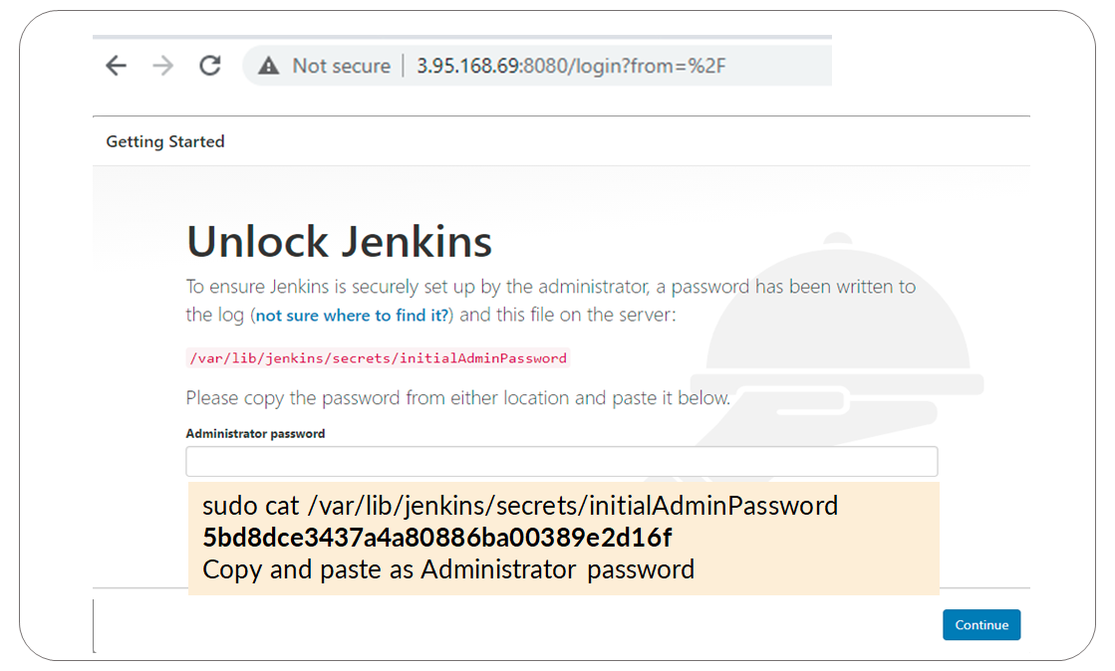
Execute https://<ipaddress>:8080

Slide 24
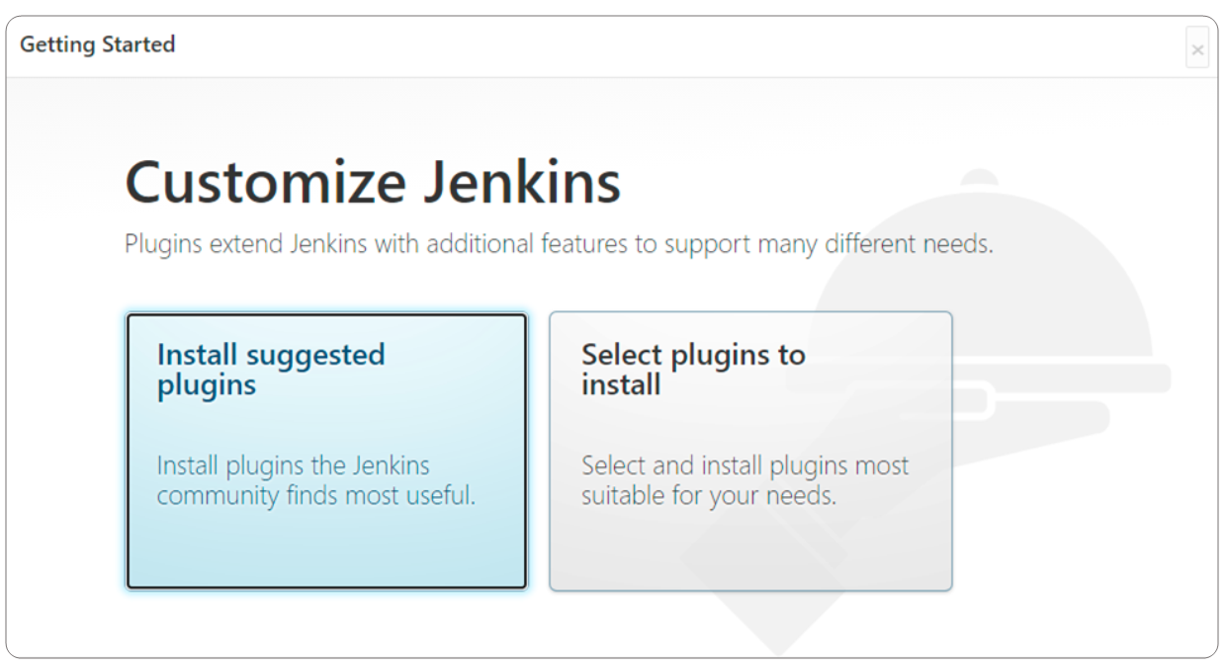
Installation of Default Plugins

Slide 25
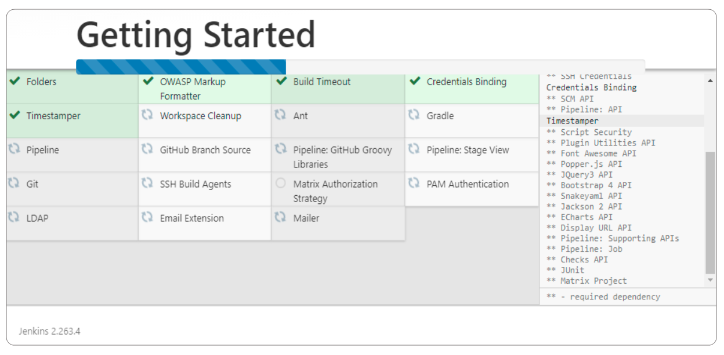
Install Suggested Plugins

Slide 26
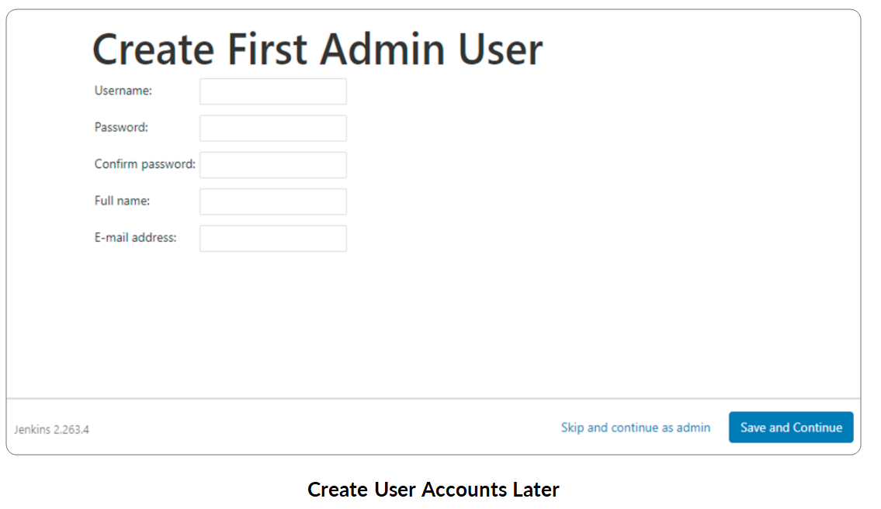
Continue as Admin

Slide 27
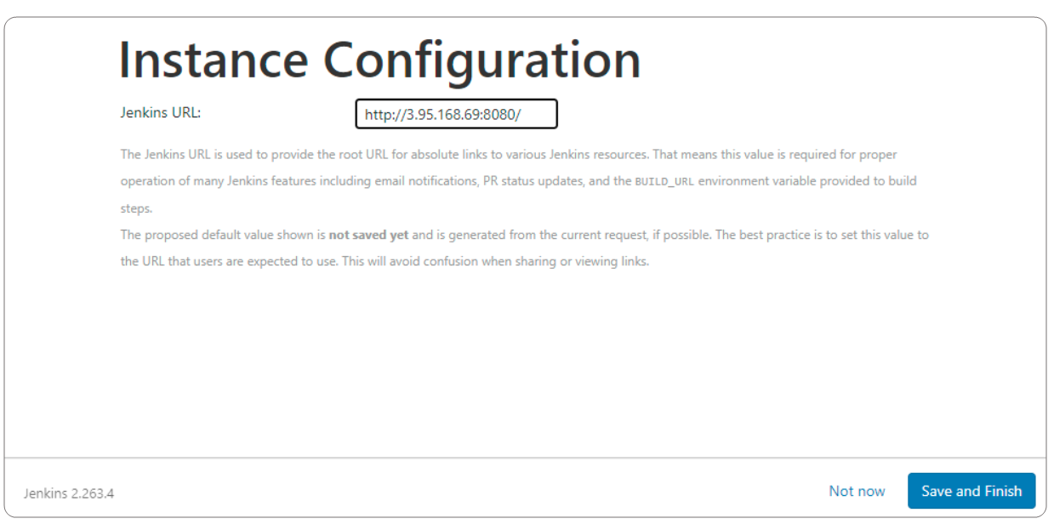
Save Jenkins Configuration

Slide 28
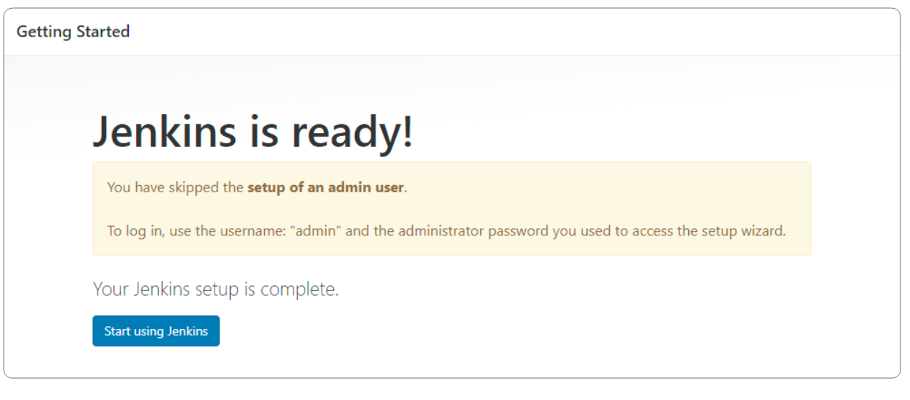
Start Jenkins

Slide 29
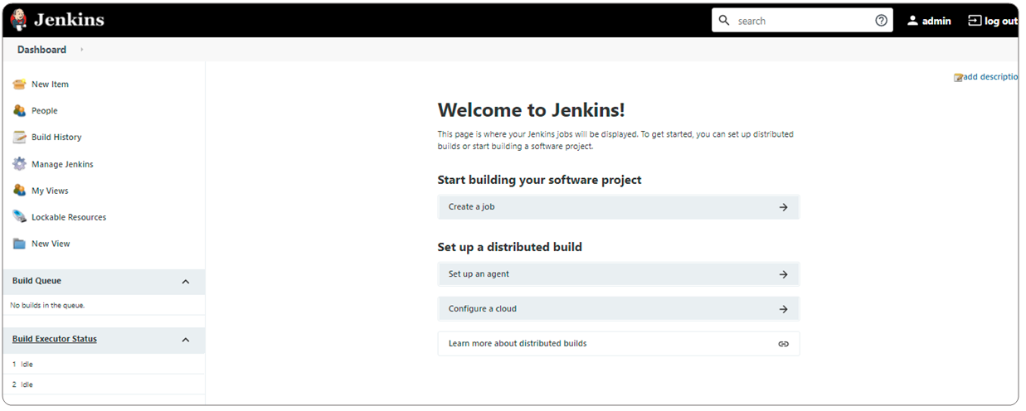
Jenkins Dashboard

Slide 30
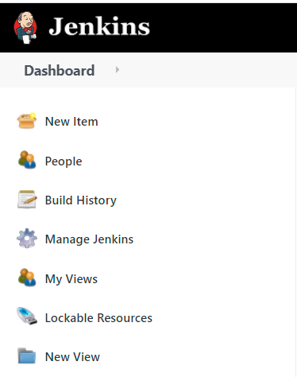
Dashboard – Various Options
Notes:
Lockable resources such as printers, phones, computers, etc. that can be used by builds. If a build requires a resource which is already locked, it will wait for the resource to be free.

Slide 31
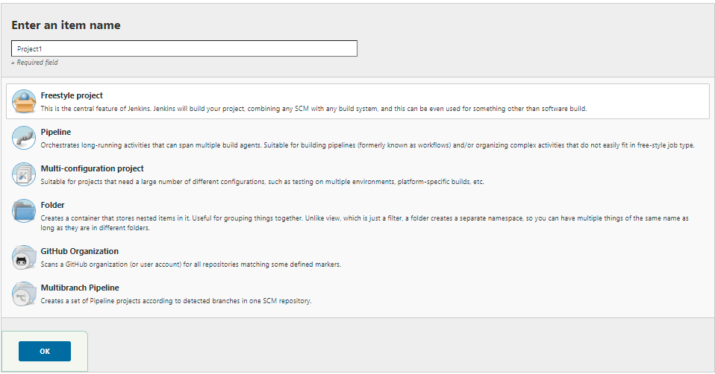
Select New Item
Notes:
Multi-configuration projects, allow you to run the same build with different input parameters.
Folders: Jenkins provides the ability to organize jobs into a hierarchical manner with the Folders Plugin. This allows us to manage the jobs much like how we are using files on a file system. Folders can also be used to manage permissions on a per folder basis to ease security administration.
If your organization utilizes GitHub Organizations any time a developer creates a new repository with a Jenkinsfile, Jenkins will automatically detect it and create a Multibranch Pipeline project for it.

Slide 32
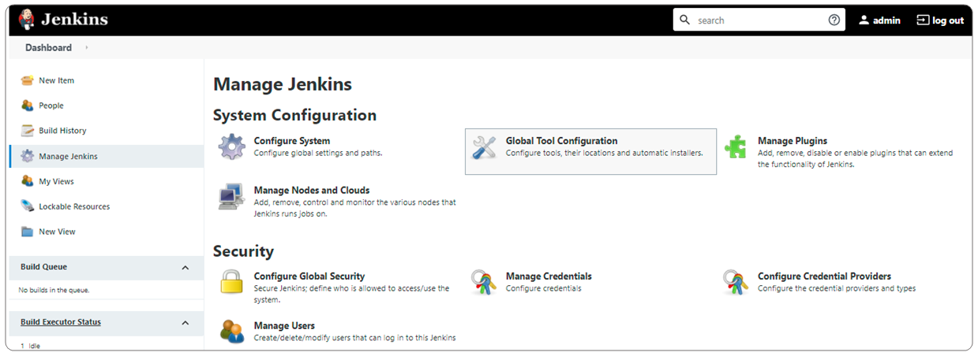
Manage Jenkins – Various Options

Slide 33
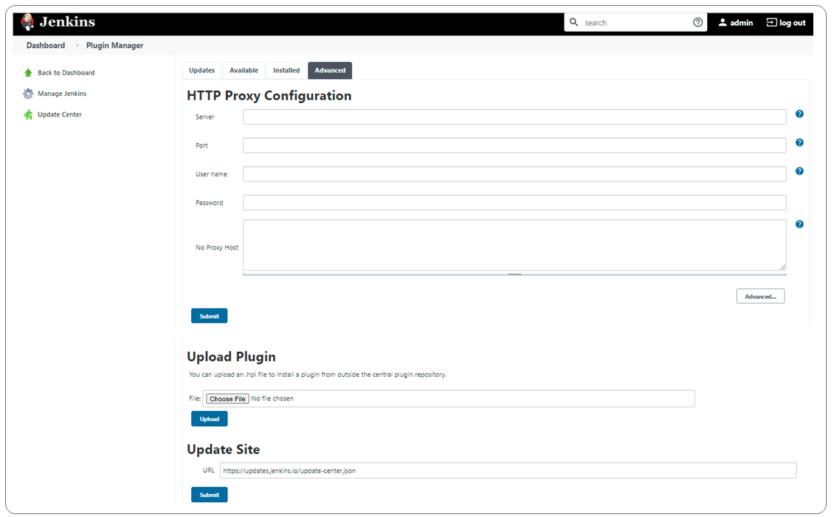
Jenkins Plugin Manager – Advanced
Notes:
If you are behind the proxy environment, then you must configure your proxy settings in Jenkins to download and install any plugins.

Slide 34
Understand How to Create Jobs in Jenkins

Slide 35
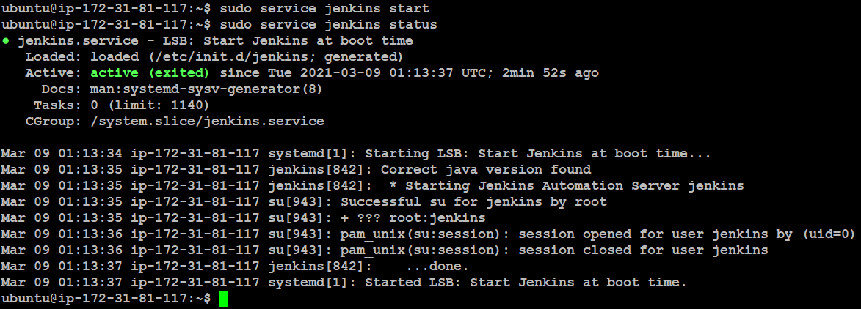
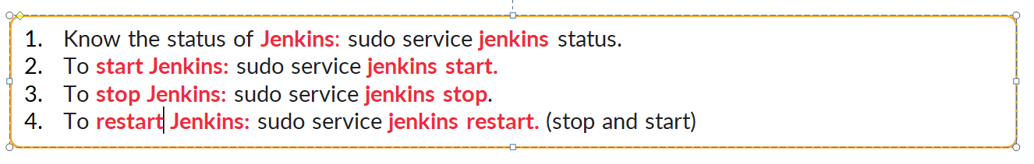
Start Jenkins

Slide 36
Jenkins Workspace
Jenkins home directory:
ubuntu@ip-172-31-81-117:~$ sudo su - jenkins
jenkins@ip-172-31-81-117:~$ pwd
/var/lib/jenkins
jenkins@ip-172-31-81-117:~$
Jenkins home directory: /var/lib/jenkins
It contains the details of the Jenkins server configuration, which is used to configure in the Manage Jenkins. The core configuration files are stored in config.xml.
It contains two important subdirectories: jobs and workspace.
Jobs directory contains configuration details of the build job in config.xml file.
Jenkins builds the given project in the workspace directory. Each project has its own directory in the workspace.

Slide 37
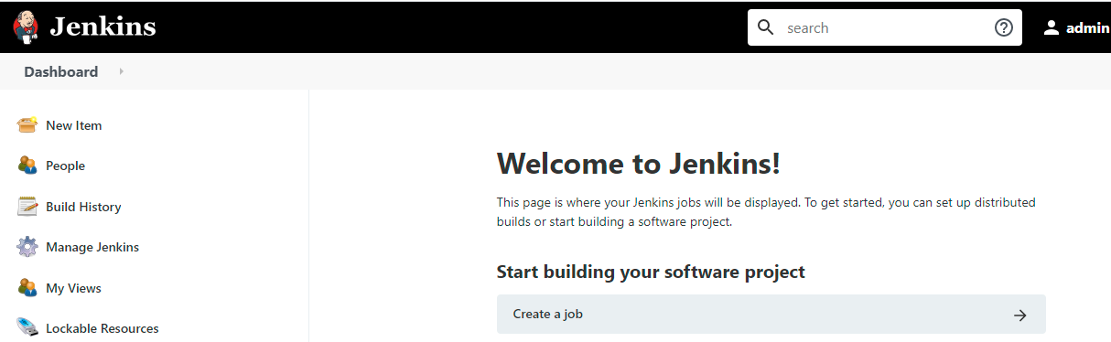
Click to Create a Job

Slide 38
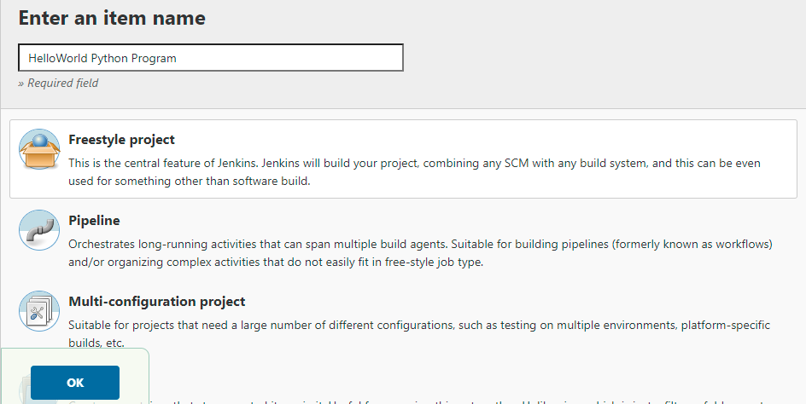
Freestyle Project

Slide 39
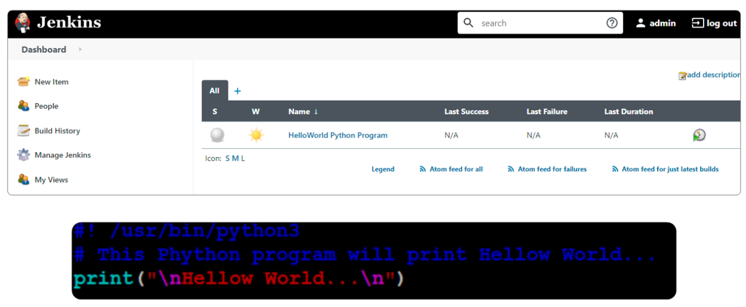
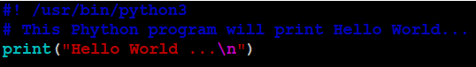
Example: HelloWorld Python Program

Slide 40
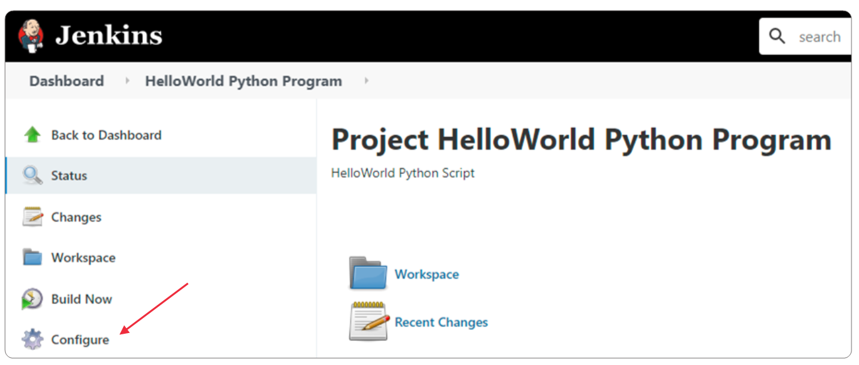
Build the Project

Slide 41
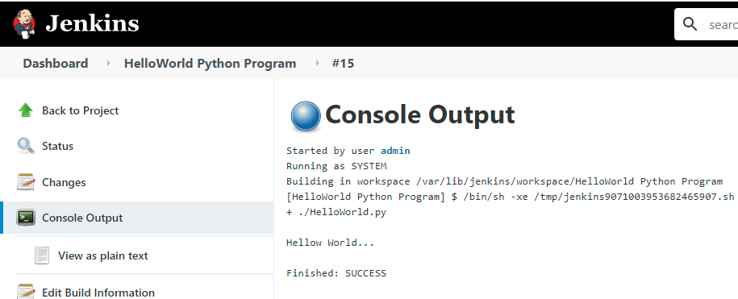
Console Output

Slide 42
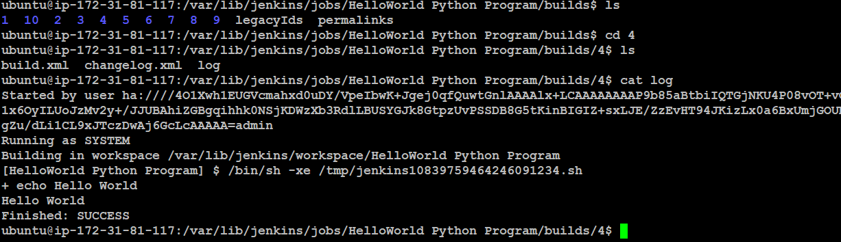
Check Log Files

Slide 43
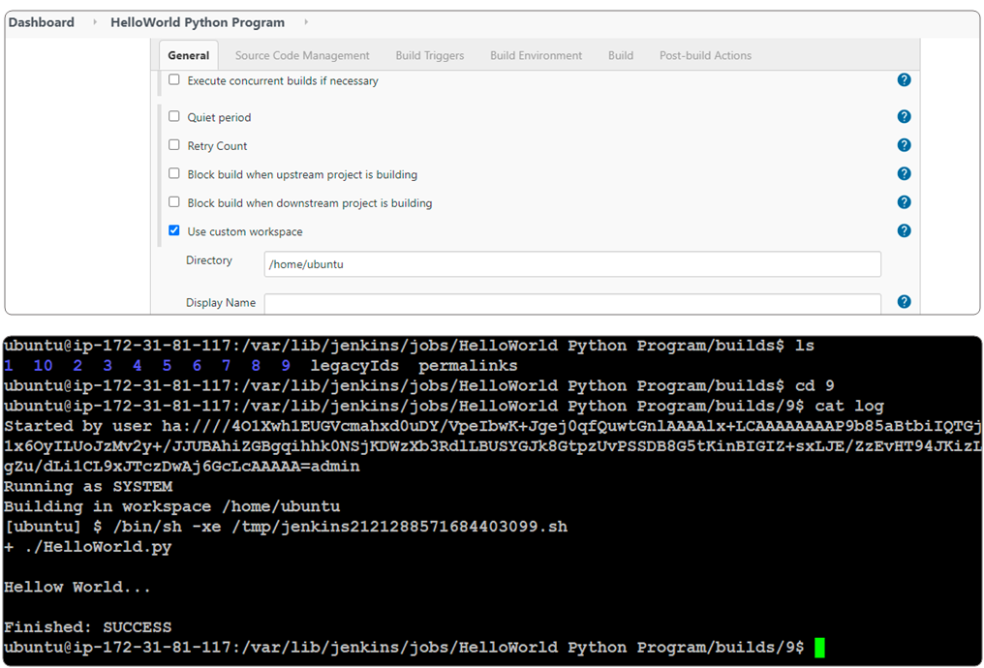
Custom Workspace

Slide 44
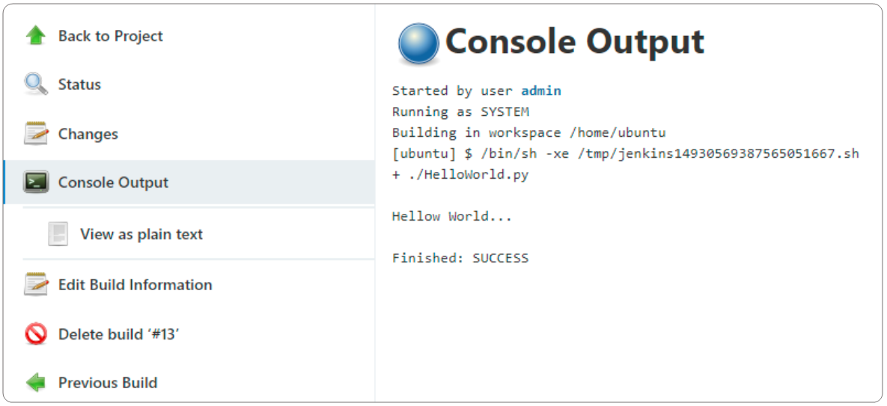
Custom Workspace: Console Output

Slide 45
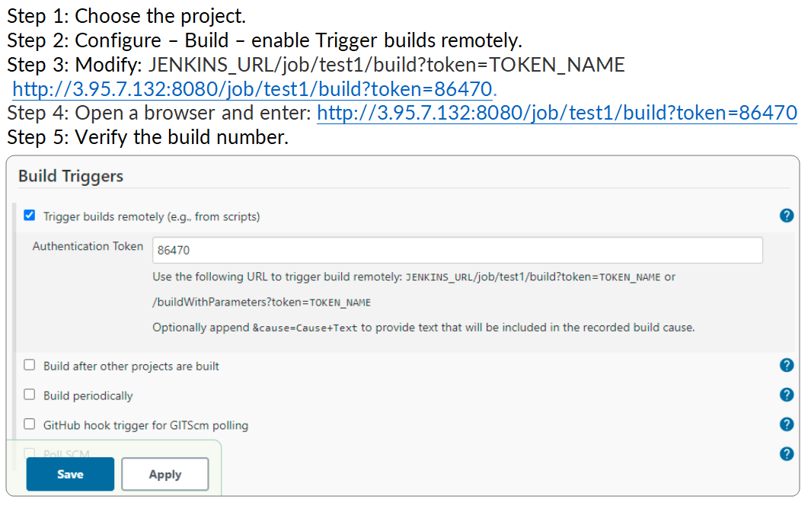
Build Jenkins Job Remotely

Slide 46
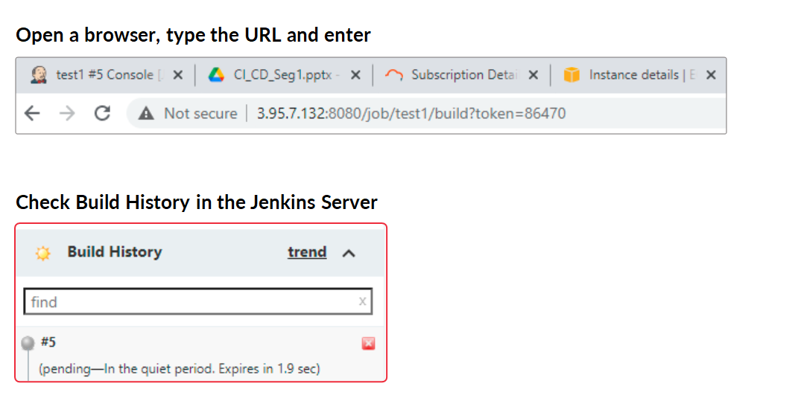
Trigger Build Job by URL

Slide 47
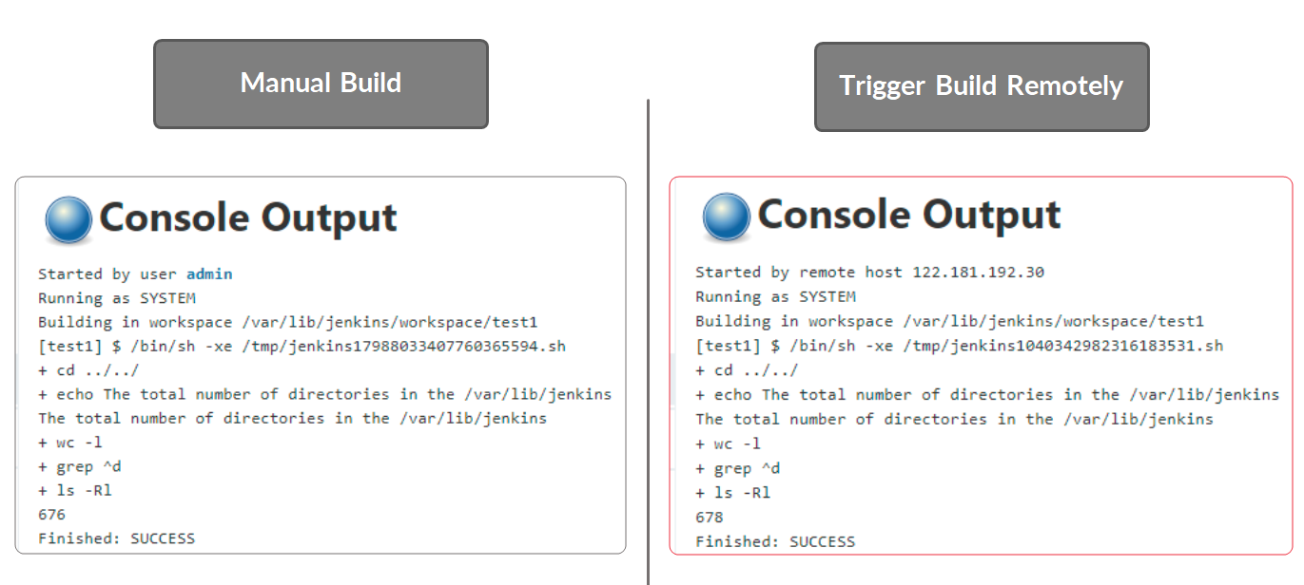
Build by Remote Host – Check Console Output

Slide 48
Job Chaining in Jenkins
Create 3 Jobs:
Job1: CPU INFORMATION
Job2: RAM INFORMATION
Job3: DISK INFORMATION
Job2 will start after Job1 build is successful
Job3 will start after job2 build is successful

Slide 49
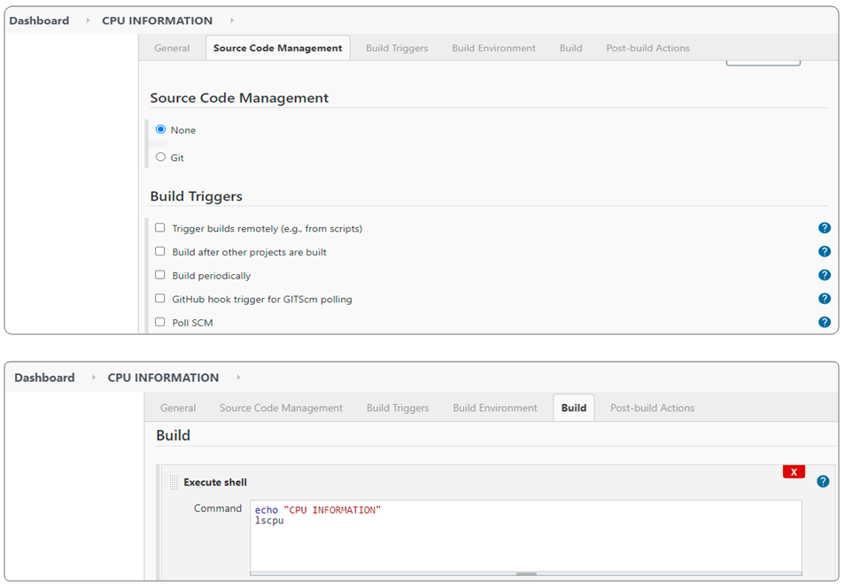
Job Chaining in Jenkins – Job1 Configuration

Slide 50
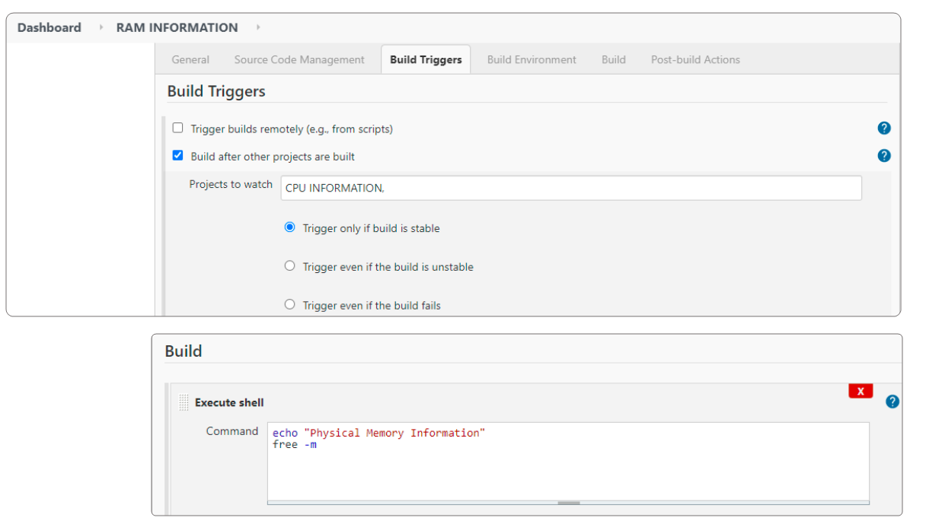
Job Chaining in Jenkins – Job2 Configuration

Slide 51
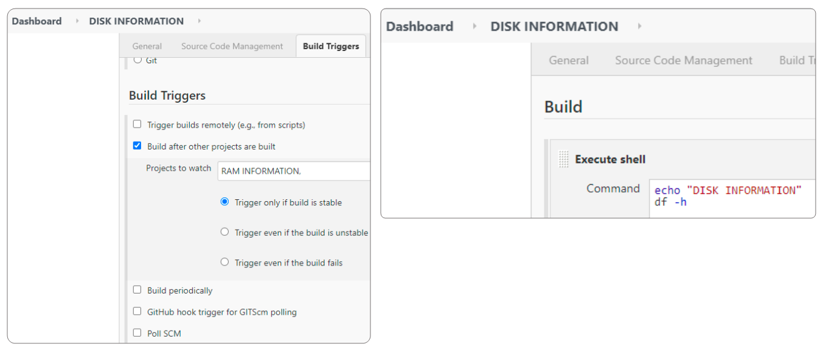
Job Chaining in Jenkins – Job3 Configuration

Slide 52
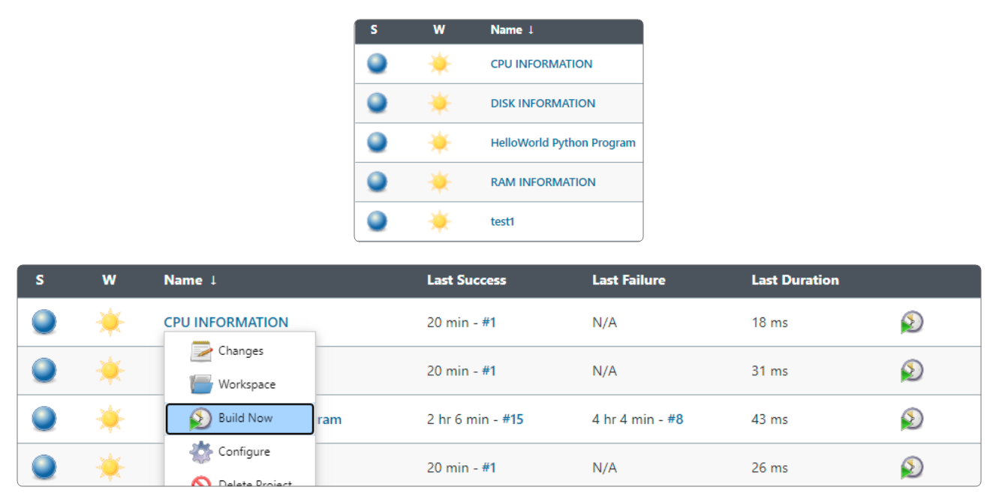
Build Job1 – CPU INFORMATION

Slide 53
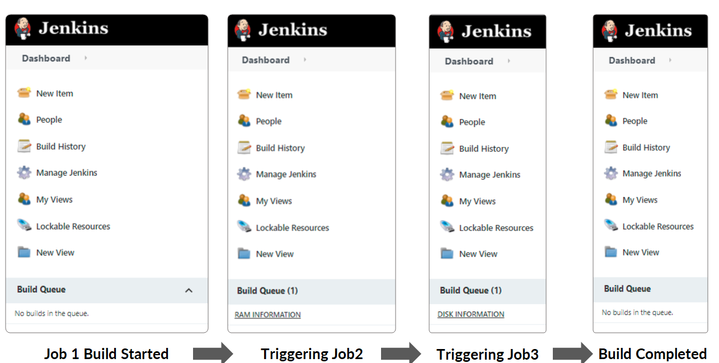
Monitor Job Chaining Builds

Slide 54
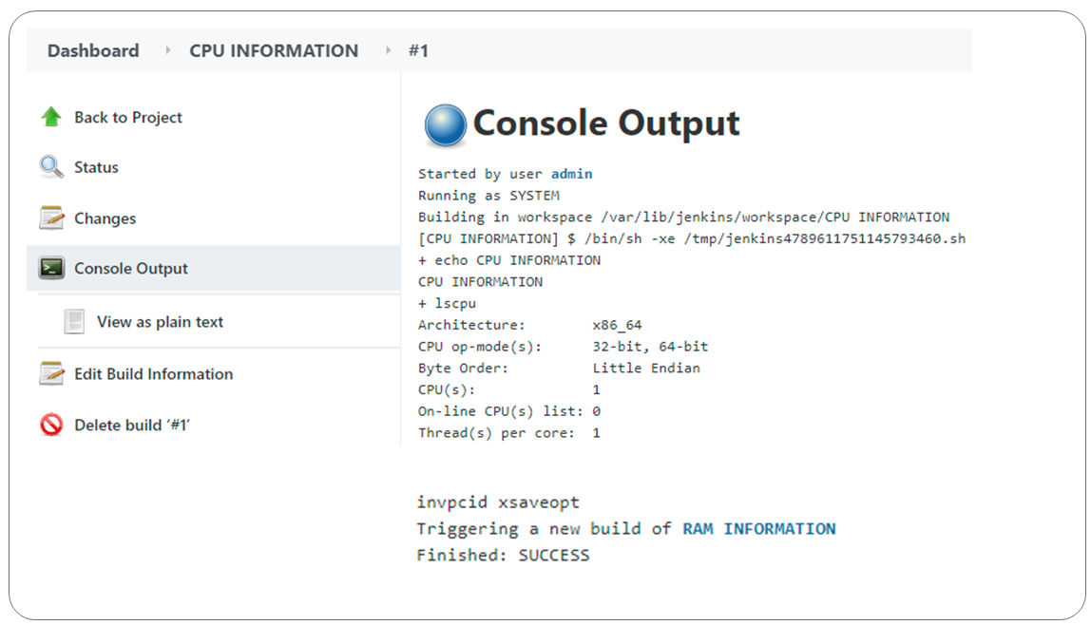
CPU INFORMATION – Console Output

Slide 55
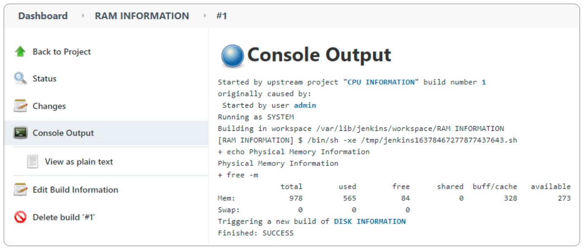
RAM INFORMATION – Console Output

Slide 56
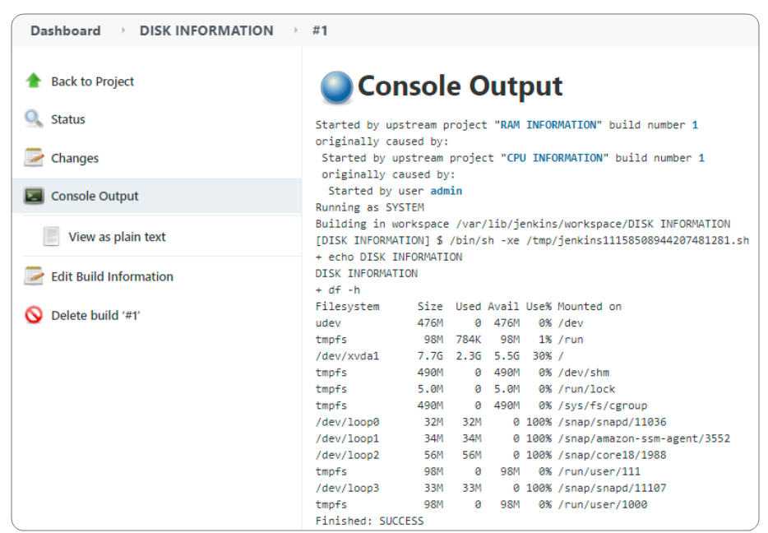
DISK INFORMATION – Console Output

Slide 57
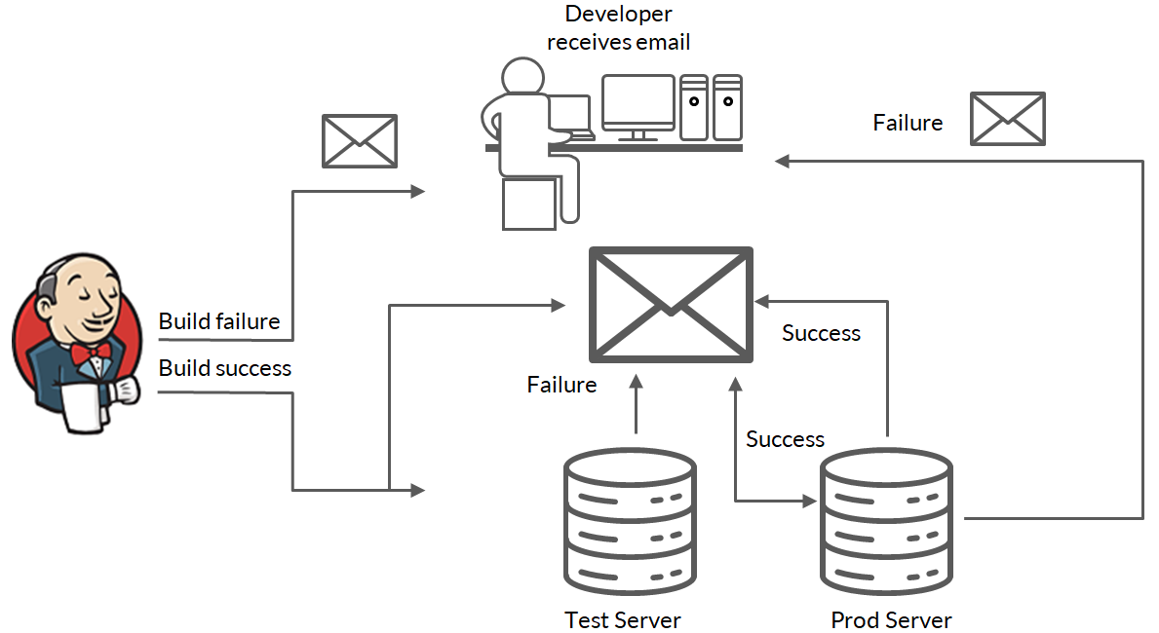
Email Notification

Slide 58
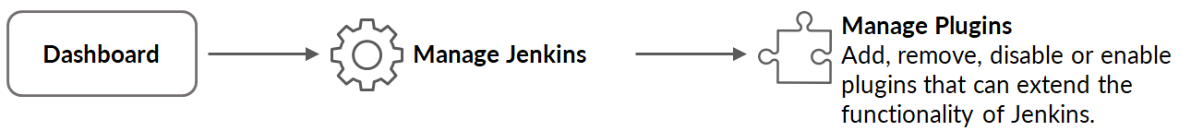
Jenkins Email Notification Configuration
If build failed or the build status changed from failed to success, then Jenkins has a provision to send an email notification to the given recipients.
Install Email Extension Plugin and Mailer Plugin

Slide 59
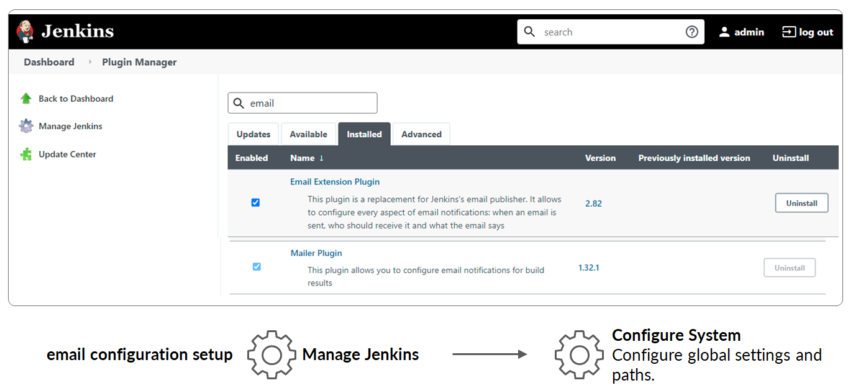
Email Configuration Setup

Slide 60
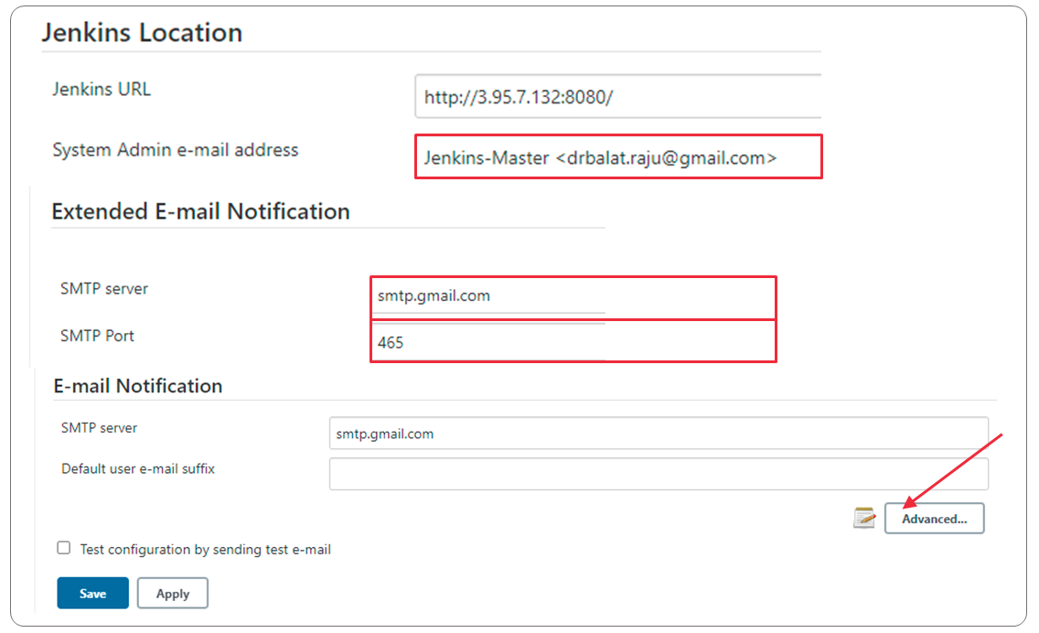
Email Configuration Setup
Notes:
The Simple Mail Transfer Protocol is an internet standard communication protocol for electronic mail transmission.

Slide 61
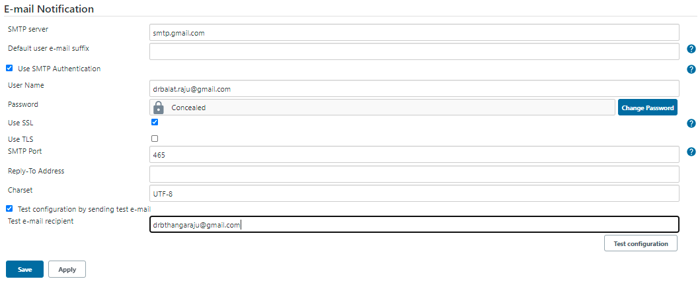
Email Configuration Setup
Password is copied from google app password.
Notes:
Transport Layer Security (TLS) is the successor protocol to Secure Socket Layer (SSL). TLS is an improved version of SSL.
It works in much the same way as the SSL, using encryption to protect the transfer of data and information.
The two terms are often used interchangeably in the industry although SSL is still widely used.
UTF-8 is a variable-width character encoding used for electronic communication. Defined by the Unicode Standard, the name is derived from Unicode Transformation Format – 8-bit.

Slide 62
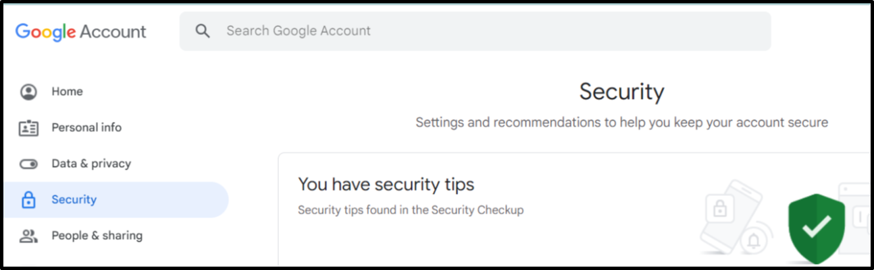
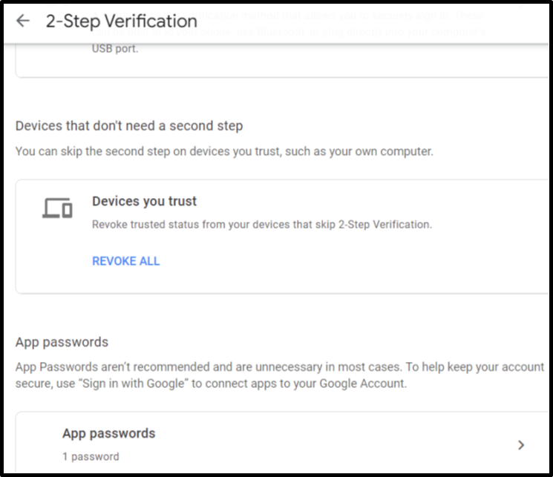
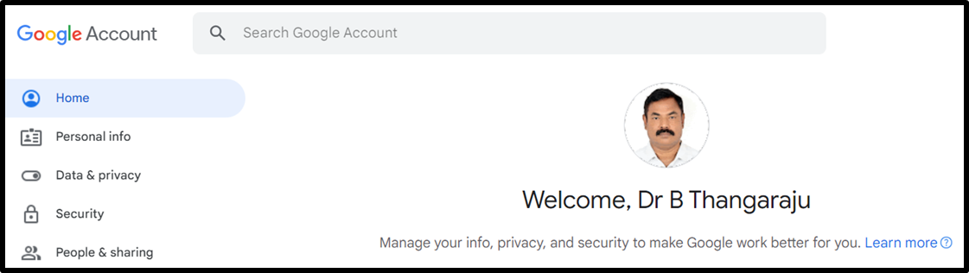
Configure Jenkins email notification with gmail
3
1
3
4
2

Slide 63
Configure Jenkins email notification with gmail
Copy and past it in Jenkins email configuration setup
6
5
Select
Select

Slide 64

Post-Build Actions for a Project

Slide 65

Email Notification

Slide 66

Email Notification

Slide 67


Email Notification

Slide 68
Parameterized Jenkins Job

Slide 69

Parameterized Project
Step1. Create a freestyle project: calculator parameterized
Step 2. Develop a simple calculator shell program in the default workspace
Step 3. During execution, you can choose the a, b and choice through Jenkins ‘This project is parameterized’ option

Slide 70

Enter the First and Second Parameters
Notes:
Boolean: true or false
Choice: a pre-defined set of strings from which a user can pick a value
Credentials: a pre-defined Jenkins credential
File: the full path to a file on the filesystem
Multi-line String: same as String, but allows newline characters
Password: similar to the Credentials type, but allows us to pass a plain text parameter specific to the job or pipeline
Run: an absolute URL to a single run of another job
String: any combination of characters and numbers

Slide 71

Choice Parameter

Slide 72

Build Step

Slide 73

Build Job With Parameter

Slide 74

Variables Values and Select Choice

Slide 75

Console Output

Slide 76
Understand How to Manage Users in Jenkins

Slide 77
Importance of User Management
In a typical project environment, many employees working on a project can access the Jenkins server to run their build or test jobs. This can create security and authorization issues.
So, you need to give every Jenkins user appropriate permission to enable the Jenkins server's safety and security.
In Jenkins, different configuration options are available to enable, edit or disable various security features.
By default, anonymous users have no permissions and logged in users have complete control.

Slide 78
Importance of User Management
Jenkins admin manages these users based on their roles. Jenkins provides capabilities to add users, edit users and provide different roles to each user. For this, Jenkins provides a role-based authentication plugin.
The ‘Configure Global Security’ option helps a Jenkins administrator to enable, configure or disable key security features to the Jenkins environment.

Slide 79
Security Realm
To configure authentication and authorization schemes in Jenkins, you need to use Security Realm and Authorization configurations.
Security Realm informs the Jenkins environment how and from where to pull user information.
Authorization configuration informs the Jenkins environment about which users can access which aspects of Jenkins and to what extent.
The Security Realm/authentication specifies who can access the Jenkins environment, whereas Authorization specifies what they can access.
Matrix-based security allows the administrator a granular control over assigning users:
Provides the most security and flexibility
Recommended for production environments

Slide 80
Role-Based Authentication Strategy
Used to add a new role-based mechanism to manage users’ permission
Roles can be assigned to users and user groups
Global Roles: Admin, Developer, Tester, QA and Anonymous
Allow to set permission: Agent, Job, Run, View and SCM
Project/Item roles: Allow additional access control for each project separately in the Project configuration screen and give access control to specific user to access only the specified projects
Agent roles: Set node-related permissions

Slide 81

Required Plugins

Slide 82
Demo
Create two users: Developer and Tester
Configure Global Security: Enable Role-based Authentication strategy
Manage and Assign roles:
Manage roles: Create a Global Roles - add ProjectMember and enable only required access
Item roles: Create two roles - Developer and Tester. Enable all the options.
Manage and Assign roles: Add Developer and Tester as ProjectMember
Item roles: Developer and Tester users should be assigned to Developer and Tester roles, respectively. Set pattern as Prog.* for Developer and Test.* for Tester
Create two projects: Program1 and TestProject1
Login as Developer or Tester and view/build/create/delete the Projects

Slide 83

User Account Creation

Slide 84

List and Delete User

Slide 85


Enable Role-Based Authentication Strategy

Slide 86





Manage and Assign Roles
Handle permissions by creating roles and assigning them to users/groups

Slide 87

Manage Roles
Add ProjectMember role in Global roles and enable required permissions
Add Developer and Tester roles and set pattern as Prog.* for Developer and Test.* for Tester.

Slide 88

Assign Roles: Global and Item Roles

Slide 89

List of Projects Created

Slide 90

Login as Developer and View the Dashboard
Developer can view only the jobs started with Prog.*
Developer can build the available Job.
Developer can create a new development job, but the job name should starts with Prog.
Developer cannot see: Tester projects, configure the system and manage plugin.

Slide 91

Login as Tester and View the Dashboard
Tester can view only the jobs started with Test.*
Tester can build the available Job
Tester can create a new test job, but the job name should starts with Test.
Tester cannot see: Developer projects, configure the system and manage plugin

Slide 92

Tester: Build and Verify

Slide 93
Integrating Jenkins With Git

Slide 94

Introduction
So far, We have seen how to Trigger build remotely and build after other projects are built (chains of Jenkins job).
Build periodically – You can trigger the jobs periodically with crontab time format.
In this section, let’s see how to GitHub hook trigger for GitScm polling and Poll SCM.
First we need to integrate with GitHub repository.
Next, Install Git Plugin.

Slide 95

Install Git Plugin

Slide 96
Poll SCM
Poll Source Code Management (SCM) vs Build Periodically
Build Periodically: Jenkins builds periodically even if there are no changes in the project.
Poll SCM: Jenkins builds periodically only if any new changes are made in the project.
Poll SCM
* * * * * - for every minute, Jenkins polls periodically the GitHub to check whether any new commits were made.
If there are any changes pushed since the last build, then Jenkins automatically builds the project.

Slide 97

Create a New Freestyle Project

Slide 98

Copy Your Project GitHub URL

Slide 99

Enable Git
Select Git in the Source Code Management and enter GitHub URL in the given Repository URL option.

Slide 100

Poll SCM Fields and Format

Slide 101

Select Poll SCM and Enter the Value

Slide 102

Enter Command to Execute the Project

Slide 103


Jenkins Dashboard
HelloWorld.py Source Code

Slide 104

Console Output

Slide 105


Commit Changes and Build Automatically

Slide 106

GitHub Hook Trigger for GITScm Polling

Slide 107

Working With Webhooks

Slide 108

Working With Webhooks

Slide 109

Working With Webhooks

Slide 110
ngrok - secure introspectable tunnels to localhost
Ngrok exposes local servers behind NATs (Network Address Translation) and firewalls to the public internet over secure tunnels.
ngrok provides a real-time web UI where you can introspect all HTTP traffic running over your tunnels.
ngrok allows you to expose a web server running on your local machine to the internet. Just tell ngrok what port your web server is listening on.
Example: Expose a web server on port 80 of your local machine to the internet. $ngrok http 8080
If different port number for ex: 5001 then: $ngrok http https://localhost:5001

Slide 111

ngrok - secure introspectable tunnels to localhost
Ngrok exposes local servers behind NATs (Network Address Translation) and firewalls to the public internet over secure tunnels.
ngrok provides a real-time web UI where you can introspect all HTTP traffic running over your tunnels.

Slide 112

Ngrok Architecture

Slide 113

Ngrok Connection

Slide 114
sudo tar xvzf ~/Downloads/ngrok-stable-linux-amd64.tgz -C /usr/local/bin
Ngrok Installation
Sign up in https://ngrok.com/
Download ngrok from: https://bin.equinox.io/c/4VmDzA7iaHb/ngrok-stable-linux-amd64.tgz
Then extract ngrok from the terminal: $sudo tar xvzf ~/Downloads/ngrok-stable-linux-amd64.tgz -C /usr/local/bin
Copy Authtoken from: https://dashboard.ngrok.com/get-started/your-authtoken
Add Authtoken: $ngrok authtoken <token>
Execute $ngrok http 8080; copy the public ip address for your local host.

Slide 115

4
3
5
1
6
7
2
8

Slide 117






Secret Text creation -GitHub
3
2
1
4

Slide 118



Webhook Configuration -GitHub
copy
5
Secret Text
1
Create Webhook from Github repository
3
2

Slide 119

Webhook Configuration -GitHub
4
Copied from ngrok public IP address
Copy from personal access tokens from webhook configuration - GitHub
5
6

Slide 120







GitHub Server Configuration –Jenkins Dashboard
2
ngrok public IP address
3
1
4
5
6
Copy from personal access tokens from webhook configuration - GitHub

Slide 121
GitSCM Polling
Ngrok
Public IP
Secret Text
Jenkins Dashboard
Secret Text
Public IP
GitHub
Webhook
Secret Text
Public IP

Slide 122
Introduction to Jenkins Pipeline

Slide 123
Jenkins Pipeline Introduction
Pipeline:
It can be specified as code, so you can write pipeline script and maintain version control in the Git repository.
It will provide continuous release of the application.
Sequence of stages to perform the given tasks such as pulling code from the Git repository, static code analysis, building project, executing unit test, automated tests, performance tests and deploying application.

Slide 124
Types of Pipeline
Declarative
New method
Easy to use for beginners
Groovy language skill is desirable
Scripted
Traditional
Based on Groovy Domain Specific Language (DSL)
Multiple features - very expressive and flexible tool
Difficult to use for beginners
Should have working experience on Groovy language

Slide 125
Declarative vs Scripted Pipeline Script Template
pipeline {
agent any
stages {
stage(‘build code’) {
steps {
/*write steps */
}
}
stage (‘test’) {
steps {
/*write steps */
}
}
}
}
node {
stage (‘build code’ {
/*write steps */
}
stage (‘test’) {
/*write steps */
}
}
Scripted Pipeline Script
Pipeline – contains all the script content
Agent and Node – defines the agent where the pipeline will run
Stages – contains all the stages
Steps – way to execute various jobs
Declarative Pipeline Script

Slide 126
Pipeline Directives
Directive allows you to define a list of parameters to be used in the script. Parameters should be provided once the pipeline is triggered.
Environment – defined as environment variables
Input – prompt for input
Options – configure pipeline-specific options like retry, timeout, etc.
Parallel – list of nested stages to be run in parallel
Parameters – list of parameters to provide when triggering the Pipeline (e.g., string, password)
Post – run at the end of a Pipeline’s execution (e.g., add some notification or other end of Pipeline tasks)
Notes:
Directive allows you to define a list of parameters to be used in the script. Parameters should be provided once the pipeline is triggered.

Slide 127
Pipeline Directives
Tools – defining tools or packages to auto-install and put on the PATH (e.g., maven. Jdk, gradle)
Triggers – determines how pipelines should be triggered (e.g., cron, poll SCM)
When – determine executing stage depending on the given condition
Jenkins Pipeline Syntax: https://www.jenkins.io/doc/book/pipeline/syntax/

Slide 128
Jenkins Pipeline
Pipeline:
Defined as a suite of plugins that helps you orchestrate simple or complex automation
Jenkins Pipeline:
Provides tool for modeling delivery pipelines, “as Code” (Pipeline as Code)
Implement and integrate CD pipeline.
CI/CD Pipeline:
Integrates SDLC stages, steps to execute tasks in each stage, trigger jobs for a given order and show pipeline status with logs
Automation from Continuous build to Continuous Monitoring (build, test, staging, deploy and monitor)

Slide 129

Demo – Jenkins Pipeline CI/CD
Declarative Pipeline Script

Slide 130

Demo – Jenkins Pipeline CI/CD

Slide 131

Demo Programs

Slide 132


Demo Programs

Slide 133

Integration With Git

Slide 134
Git Clone, Build and Test a Python Script
pipeline {
agent any
stages {
stage('Clone Git') { /*you can also specify git location */
steps {
git 'https://github.com/BThangaraju/Jenkins.git'
}
}
stage('Build Code') {
steps {
sh "chmod u+x Prog1.py"
sh "./Prog1.py"
}
}
stage('Test Code') {
steps {
sh "chmod u+x Test.py"
sh "./Test.py"
}
}
}
}
You can execute any commands for example:
You can compile and execute a.c
sh “gcc a.c”
sh “./a.out”

Slide 135

Pipeline View

Slide 136
Jenkins Distributed Architecture

Slide 137
Scaling Jenkins
Initially, when you start working with Jenkins, you have a single server to carry out all the tasks. The single Jenkins server is also called as Master node or Jenkins controller.
Single Jenkins server is not enough to meet certain requirements like:
When you configure more jobs
When you orchestrate more frequent builds
When more developers depend on one controller
When you add incremental features in large and complex projects frequently
When you need different environments (diff OS) to test the build

Slide 138
Scaling Jenkins
Instead of adding new team members or new projects to an existing single Jenkins controller, you can create additional Jenkins controllers to accommodate new teams or projects.
The Jenkins distributed architecture enables us to use various environments for each build project, dividing the workload across multiple agents running jobs concurrently.
Jenkins' distributed architecture is based on the idea of ‘Master + Agent’. The master is responsible for coordination and providing the GUI and API endpoints, while the Agents perform the work.
The Jenkins master manages the Jenkins agents and orchestrates their work by scheduling jobs on agents and monitoring them.
Agents can link to the Jenkins controller via local or cloud computers.

Slide 139

Jenkins Distributed Architecture

Slide 140
SSH Key
SSH key is a secure access credential used in the Secure Shell (SSH) protocol.
SSH keys use key pairs based on public key infrastructure (PKI) technology, the gold standard for digital identity authentication and encryption, to provide a secure and scalable method of authentication.
As the SSH protocol is widely used for communication in cloud services, network environments, file transfer tools, configuration management tools, and other computer-dependent services, to authenticate identity and protect those services from unintended use or malicious attacks.
SSH keys not only improve security, but also enable the automation of connected processes, single sign-on (SSO), and identity and access management at scale that today’s businesses require.

Slide 141
SSH Key
The SSH key pair : Private and Public key. The public key is used by both the user and the remote server to encrypt messages.
On the remote server side, it is saved in a file that contains a list of all authorized public keys.
On the user’s side, it is stored in SSH key management software or in a file on their computer.
The private key remains only on the system being used to access the remote server and is used to decrypt messages.
In computer security, challenge-response authentication is a set of protocols used to protect digital assets and services from unauthorized users, programs or activities.

Slide 142

SSH Key
When a user or process requests a connection to the remote server using the SSH client, a challenge-response sequence is initiated to complete authentication.
The SSH server recognizes that a connection is being requested and sends an encrypted challenge request using the shared public key information.
The SSH client then decrypts the challenge message and responds back to the server.
This challenge-response sequence happens automatically between the SSH client and server without any manual action by the user.
Ref: https://sectigo.com/

Slide 143
Host Setup
From Host:
#sudo su - jenkins
#ssh-keygen
#ls .ssh/; id_rsa id_rsa.pub
Docker Setup:
#sudo apt-get install docker.io
#sudo service docker status
#sudo docker pull ubuntu
#sudo docker run --it --name Jenkins_Agent ubuntu /bin/bash
In the browser: Manage Jenkins -> Manage Credentials -> click global -> click Add Credentials -> for Kind -select ssh username with private key and enter the details.
ID: Master_Jenkins_Private_key
Description: Jenkins Master Private Key to Add Multiple Agents
Username: jenkins
Private Key -> Enter Directly ->copy and paste id_rsa from the server (/var/lib/jenkins/.ssh/id_rsa)
Notes:
"GnuPG uses public-key cryptography so that users may communicate securely. In a public-key system, each user has a pair of keys consisting of a private key and a public key. A user's private key is kept secret; it need never be revealed.
The public key may be given to anyone with whom the user wants to communicate."

Slide 144

Check the docker.service in Host

Slide 145

Configure Jenkins Global Credentials

Slide 146
Docker Configuration
Inside the container:
#adduser jenkins
#usermod -aG sudo jenkins
#apt-get update
#apt-get install sudo
#su - jenkins
ssh server configuration
#sudo apt-get install openssh-server
#sudo service ssh restart
#service ssh status
#sudo apt install openjdk-11-jdk
#java --version
From Host:
#ssh-copy-id jenkins@172.17.0.2
To Check Docker container:
#cat /home/jenkins/.ssh/authorized_keys
It should be same as: id_rsa.pub in host.

Slide 147

Copy Authorized Keys From Host to Container
In the Host: ssh-copy-id jenkins@172.17.0.2
Check the copied authorized_keys in the container

Slide 148

Configure Agent in Jenkins

Slide 149

Configure Agent in Jenkins

Slide 150

Create a New Project as AgentTrigger

Slide 151

Console Output

Slide 152
Benefits of Jenkins Distributed Architecture
Higher Performance
High Availability
Failover Mechanism
Enhanced Security
Rollback Mechanism from Machine Failure

Slide 153
Thank You

